Slide 1
COVID-19’s Effects on the Denver Nuggets and Colorado Sports
Zach Becker

Slide 2

The Past Year
Olympic Games
FIFA
Boston Marathon
The NBA season

Slide 3
Sports Economics
Common misunderstandings surrounding impact
During the 1999-2000 season, only 29% of NBA players resided in the surrounding area of their team during the offseason.
93% of employees who worked at the organizations lived within the surrounding area of their team
5-20% of out of state attendance per game
Opportunity cost of spending money elsewhere
Departure of the Oakland Raiders
Losing around $1,000,000 a year
3,000 employees

Slide 4
How does this affect the Denver Nuggets?
Revenue was at an all-time high in the 2019-2020 season, totaling 252 million dollars.
Using data from previous seasons I aim to estimate the total revenue lost from having no fans for the Denver Nuggets organization over the course of the pandemic.
To what magnitude has the COVID-19 pandemic effected the potential revenue of the Denver Nuggets?
How has the cancellation of the major sports leagues trickled down into the local Colorado communities?

Slide 5

DATA

Slide 6
Year | AVG Ticket Price | Revenue (Millions) | Average Attendance | Total Attendance | Twitter Followers | Facebook Followers
01/02 | $38.11 | $75 | NA | NA | NA | NA
02/03 | $32.77 | $75 | NA | NA | NA | NA
03/04 | $32.77 | $89 | NA | NA | NA | NA
04/05 | $35.50 | $94 | NA | NA | NA | NA
05/06 | $36.98 | $100 | NA | NA | NA | NA
06/07 | $42.72 | $104 | 17230 | 706437 | NA | NA
07/08 | $44.29 | $112 | 17364 | 711962 | NA | NA
08/09 | $47.3 | $115 | 17223 | 706165 | NA | NA
09/10 | $47.3 | $113 | 17995 | 737812 | NA | NA
10/11 | $47.3 | $113 | 16901 | 692968 | NA | NA
11/12 | $47.3 | $110 | 16930 | 561966 | 150000 | 930000
12/13 | $47.3 | $124 | 17819 | 730616 | 270000 | 1480000
13/14 | $54.23 | $136 | 16899 | 692898 | 370000 | 1830000
14/15 | $53.15 | $140 | 14700 | 602707 | 460000 | 1900000
15/16 | $54.00 | $157 | 14095 | 577898 | 600000 | 1960000
16/17 | $52.38 | $202 | 14770 | 695585 | 780000 | 1960000
17/18 | $54.14 | $222 | 17141 | 702796 | 790000 | 1960000
18/19 | $54.63 | $252 | 18450 | 756457 | 960000 | 2000000
19/20 | $54.63 | $218

Slide 7
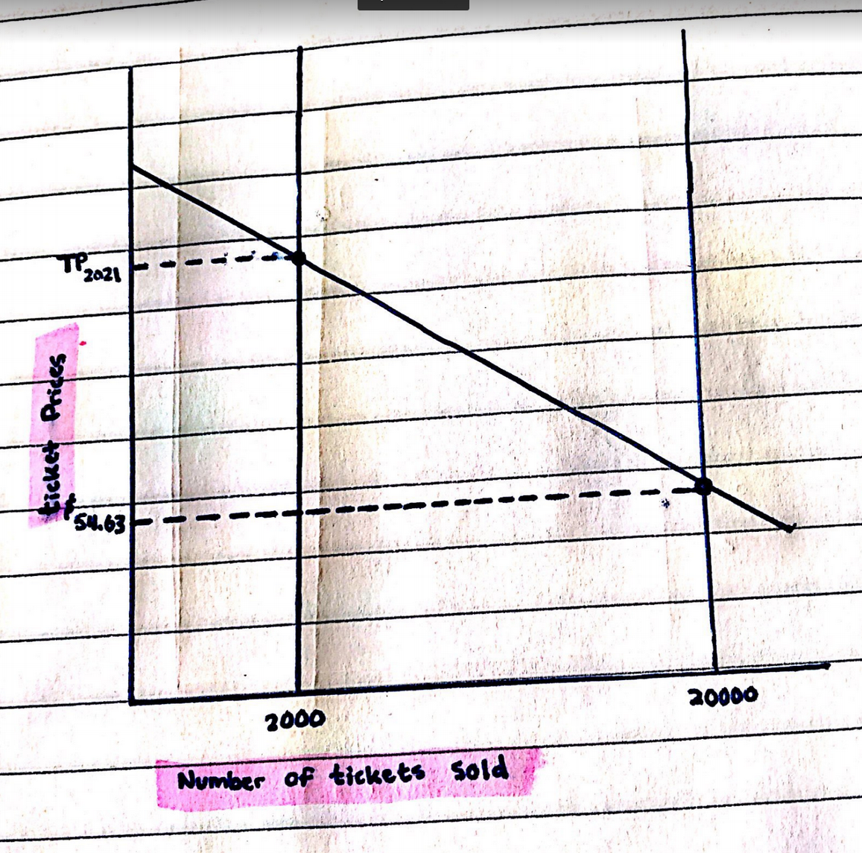

Slide 8
Time Period | Twitter followers (millions) | Facebook followers (millions) | % change Twitter | % change FB
Sep. 2012 | 0.11 | 0.86
Feb. 2013 | 0.15 | 0.93 | 4% | 7% | Playoff Appearance
Sep. 2013 | 0.23 | 1.04 | 8% | 11%
Mar. 2014 | 0.27 | 1.48 | 4% | 44%
Sep. 2014 | 0.32 | 1.67 | 5% | 19%
Mar. 2015 | 0.37 | 1.83 | 5% | 16%
Sep. 2015 | 0.41 | 1.83 | 4% | 0%
Mar. 2016 | 0.46 | 1.9 | 5% | 7% | Hiring of Coach Mike Malone
Sep. 2016 | 0.52 | 1.96 | 6% | 6%
Mar. 2017 | 0.6 | 1.96 | 8% | 0% | Above .500 Win Rate for the first time in 5 years
Sep. 2017 | 0.7 | 1.96 | 10% | 0%
Mar. 2018 | 0.78 | 1.96 | 8% | 0%
Sep. 2018 | 0.79 | 1.96 | 1% | 0%
Mar. 2019 | 0.79 | 1.96 | 0% | 0%
Sep. 2019 | 0.91 | 2.01 | 12% | 5% | Made it to W. Conference Semis
Mar. 2020 | 0.96 | 2 | 5% | -1% | Made it to W. Conference Finals
Sep. 2020 | 0.99 | 1.99 | 3% | -1%
Mar. 2021 | 1.1 | 2.04 | 11% | 5% | Jokic Frontrunner for MVP

Slide 9
Oklahoma City Thunder Attendance |  |  |  | Denver Nuggets Attendance
Year | Total Attendance | Average Attendance | Notes | Year2 | Average Attendance | Total Attendance
06/07 | 654,163 | 15,955 |  | 06/07 | 17230 | 706437
07/08 | 547,556 | 13,355 | KD Drafted | 07/08 | 17364 | 711962
08/09 | 747,732 | 18,693 |  | 08/09 | 17223 | 706165
09/10 | 738,149 | 18,003 |  | 09/10 | 17995 | 737812
10/11 | 744,068 | 18,148 |  | 10/11 | 16901 | 692968
11/12 | 600,699 | 18,203 |  | 11/12 | 16930 | 561966
12/13 | 746,323 | 18,203 |  | 12/13 | 17819 | 730616
13/14 | 746,323 | 18,203 | KD MVP | 13/14 | 16899 | 692898
14/15 | 746,323 | 18,203 |  | 14/15 | 14700 | 602707
15/16 | 746,323 | 18,203 |  | 15/16 | 14095 | 577898
16/17 | 746,323 | 18,203 |  | 16/17 | 14770 | 695585
17/18 | 746,323 | 18,203 |  | 17/18 | 17141 | 702796
18/19 | 746,323 | 18,203 |  | 18/19 | 18450 | 756457

Slide 10
Correlation Matrix
 | AVG Ticket Price | Revenue (Millions) | Average Attendance | Total Attendance | Twitter Followers | Facebook Followers
AVG Ticket Price | 1
Revenue (Millions) | 0.774934417 | 1
Average Attendance | -0.402353362 | -0.065089704 | 1
Total Attendance | -0.180215308 | 0.215047821 | 0.694388087 | 1
Twitter Followers | 0.736065904 | 0.971222896 | -0.005943499 | 0.498912541 | 1
Facebook Followers | 0.885353382 | 0.673721034 | -0.283893214 | 0.410132734 | 0.797527377 | 1

Slide 11
As a result of the COVID-19 outbreak, what are the revenue losses for the Denver Nuggets organization?

Slide 12
Hypothesis
Despite sporting events being a low-income source for their respective cities, I hypothesize that the Denver Nuggets organization would have had a record year in terms of revenue. This hypothesis also trickles down into the surrounding businesses. With the increased attention of new fans watching basketball, the surrounding economies would not see much of a difference in terms of revenue gained.

Slide 13

Equations

Slide 14
1) Revenue Lost per Game 2019-2020 = Average Attendance x (Average Ticket Price + Average Concession Spending + Average Parking Spending)
= 19186 x ($54.63 + $9 + $18) = $1,566,153 per game
2) Revenue with Full Capacity for all Home Games = Maximum Attendance x Number of Home Games x (Average Ticket Price + Average Concession Spending + Average Parking Spending)
= 20000 x 41 x ($54.63 + $9 + $18) = $66,936,600
3) Revenue per Home Game = $66,936,600 / 41 = $1,632,600 per game
4) Revenue Lost from March 2020 Shutdown = Total Revenue Lost by NBA / Number of NBA teams
= 695,000,000 / 30 = $23,170,000
5) Ticket Revenue Lost During March 2020 Shutdown = (Number of Games Cancelled / Number of NBA Teams) x Revenue Lost per Game 2019-2020
= (258 / 30) x $1,566,153 = $13,468,917

Slide 15
Discussion of Results
Total Revenue Lost = $66,936,600 + $23,170,000 + $7,000,000
= $97,106,600
Twitter Followers positively correlated with AVG ticket price, Revenue, and Total Attendance
39% of total revenue in 2019
Unknown ticket prices for 2020-2021 season
- Matches with Adrian Wojnarowski’s 40% value for ticket revenue

Slide 16
Effects on Colorado
During the 1999-2000 season, only 29% of NBA players resided in the surrounding area of their team during the offseason.
According to certain local governments throughout the state, to be eligible for monetary relief there must have been a 20% loss in revenue between March 26th, 2020 and the present
According to Justin Anthony, a local sports bar owner in Colfax, revenue has gone down over 60% since the pandemic began.
Denver bar owners Chris Fuselier and Angela Neri have experienced upwards of 50% revenue decline over the course of the pandemic
In addition to revenue losses, curfews that have been established for bars strangle what little business they can cumulate.

Slide 17
Limitations
Monthly twitter follower changes
The average ticket prices for the current season
Total revenue earned from concessions

Slide 18
Policy Recommendations
Policies aimed towards maximizing the amount of money earned from having an NBA team
Denver could utilize the space surrounding Denver to implement local businesses and hotels
Vouchers or guides should be handed out at home games that encourage tourists to visit places outside of Denver
New laws should be put in place that require NBA players to allocate a certain percent of their spending towards the communities that foster their team
New policies that directly target benefits towards local businesses that rely on sporting events

